Slide 1

The Perfect Interview
Lara Winkler

Slide 2

Preview
Before
preparation time
During
interview time
After

Slide 3
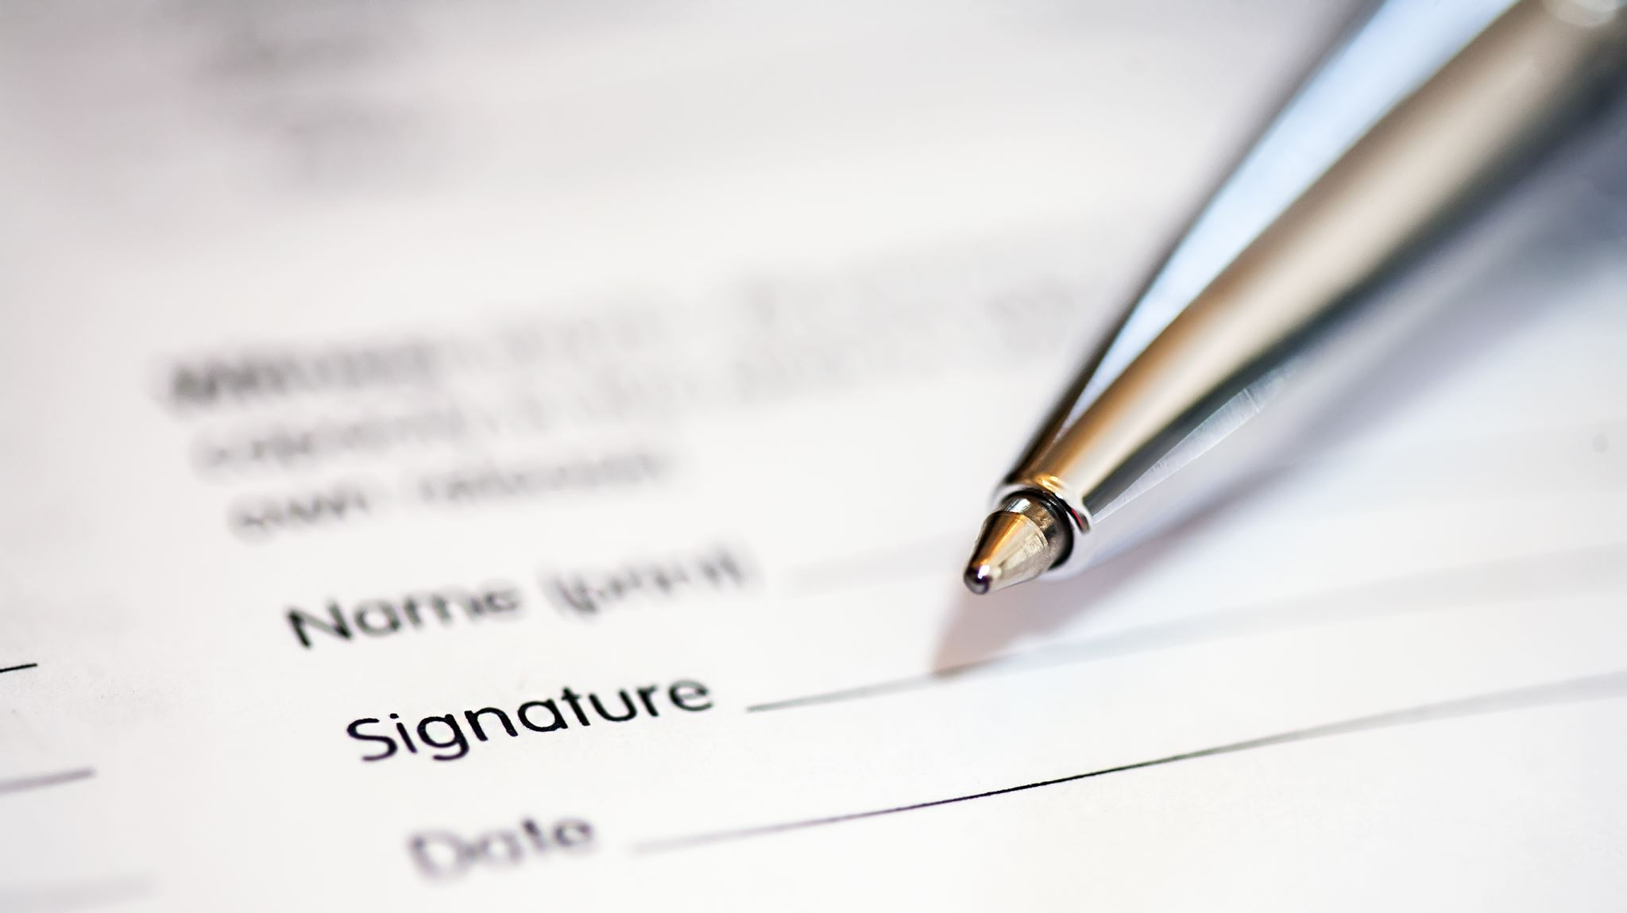
Before ”the interview starts as soon as you leave the house“
Researching the company and your interviewers
Work on Your Answers
Practice Good Nonverbal Communication
Have a pen and a small notepad with you
Dress for the Job or Company
Bring a copy of your resume to every interview

Slide 4

During
Always arrive early
Score a success in the first five minutes
Know the interviewer’s name, spelling, and pronunciation
Be prepared with examples of your work
Right body language
Make your selling points clear
Listen

Slide 5
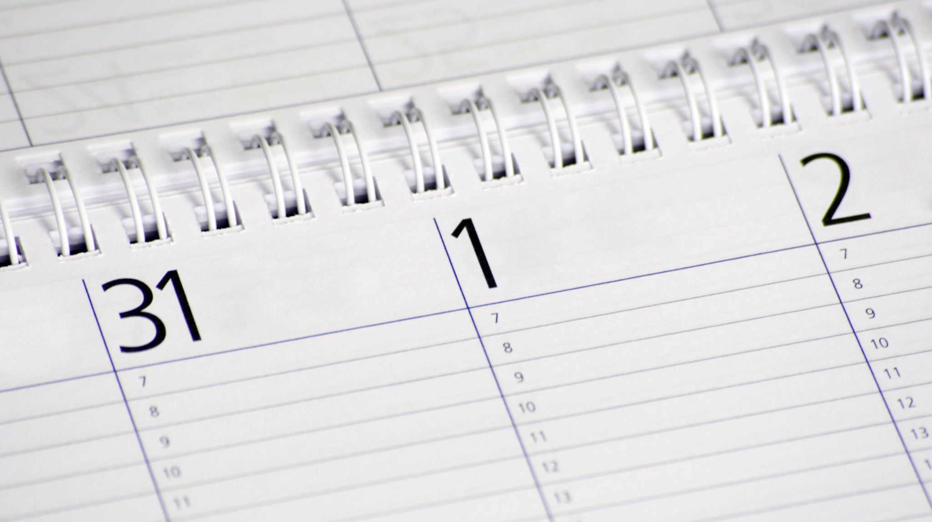
After
Ask about the next steps
Close on a positive note
Send a thank-you note
Don't give up!

Slide 6

Thank you for listening!

